Slide 1


COMPUTER ORGANIZATION & ASSAMBLY LANGUAGE
Lab 1 Introduction
Book by : Computer, Architecture and Organizations, 8th Edition ,William Stalling
Original Slides by : Adrian J Pullin

Slide 2
Introduction

Slide 3
COMPUTER ORGANIZATION & ASSAMBLY LANGUAGE
Note:
Being Disciplined shows self-respect and commitment to your education.
If anything I’ve shared doesn’t click, Please feel free to ask! I’m
always happy to clarify and can be reached via email.
Muhammad.hanif@iqra.edu.pk,
ROOM #702

Slide 4
COMPUTER ORGANIZATION & ASSAMBLY LANGUAGE
Outline:
What is Computer Organization?
Working of a Central Processing Unit (CPU)
Athematic and Logical Unit (ALU)
Control Unit
Buses
Registers
What is Assembly language?
Installation of Assembly language IDEs.
Introduction to DOSBOX & NASM.
Getting familiar to IDE

Slide 5
WHAT IS COMPUTER ORGANIZATION?
Overview: Understanding the basic structure of a computer, including the CPU, memory, input/output devices, and how they interact.
Data Representation: How data is represented in binary form (e.g., bits, bytes, words) and how arithmetic and logic operations are performed at the hardware level.
Memory Hierarchy: Study of different types of memory (cache, RAM, etc.) and how data is stored and accessed efficiently.
Instruction Set Architecture (ISA): Learning how a computer processes instructions and executes them through registers, buses, and control units.
Pipelining and Parallelism: Understanding how modern processors handle multiple instructions simultaneously.

Slide 6
Working of a Central Processing Unit (CPU)
We Can Say:
Microprocessor, Central Processor, Processor,Brain of Computer
Working:
Fetch : Keep Overall data from memory to CPU
Decoding : Convert all data in Signals
Execute : CPU decide what instruction is for which purpose
Storing : Save for Future
Components:
ALU(Arithmetic Logic Operator) : Perform Arithmetic and Logical Operations
CU(Control Unit) : Control Overall System
Register : Store Results

Slide 7
Arithmetic and Logical Unit (ALU)
The Arithmetic Logic Unit (ALU) is a critical component of the CPU (Central Processing Unit) responsible for performing arithmetic and logical operations. Here are the main functions and features of the ALU:
Arithmetic Operations: The ALU performs basic arithmetic operations such as addition, subtraction, multiplication, and division.
Logical Operations: It also handles logical operations like AND, OR, NOT, and XOR, which are fundamental for decision-making processes in programs.
Bit Manipulation: The ALU can manipulate individual bits, enabling tasks like shifting and rotating bits, which are essential for various algorithms.
Input and Output: It takes inputs from the CPU's registers, processes them, and sends the results back to the registers or memory.
Control Signals: The ALU operates based on control signals that dictate what operations to perform, usually provided by the control unit of the CPU.

Slide 8
Control Unit
The Control Unit (CU) is a crucial component of the CPU (Central Processing Unit) responsible for directing the operation of the processor. Here’s an overview of its main functions and features:
Instruction Decoding: The CU interprets the instructions fetched from memory, determining what actions the CPU needs to perform.
Control Signals Generation: It generates control signals that coordinate the activities of other components within the CPU, such as the ALU (Arithmetic Logic Unit), registers, and memory.
Timing and Sequencing: The CU manages the timing and order of operations, ensuring that instructions are executed in the correct sequence and at the right time.
Data Flow Management: It oversees the flow of data between the CPU, memory, and input/output devices, facilitating communication within the system.
Microprogramming: In some architectures, the CU uses microprogramming, where complex instructions are broken down into simpler micro-operations that the CU controls.

Slide 9
BUSES
In computing, a bus is a communication system that transfers data between components
inside a computer or between computers. Here are the main types of computer buses:
Data Bus: Transfers actual data between components, such as the CPU, memory, and
I/O devices. The width of the data bus (e.g., 8-bit, 16-bit, 32-bit, 64-bit) determines how much
data can be transmitted at once.
2. Address Bus: Carries the addresses of data (but not the data itself) so that the CPU can
locate and access memory or I/O devices. The size of the address bus determines the
maximum addressable memory space.
3. Control Bus: Carries control signals from the CPU to other components to manage
operations, such as read/write requests and interrupts.

Slide 10
Registers
Registers are small, fast storage locations within a CPU that hold data, instructions, and addresses temporarily during processing. They play a critical role in executing instructions efficiently. Here are some common types of registers.
There are two types of Registers
General Purpose Registers
AX
BX
CX
DX
Special Purpose Registers
Flag Registers
Instruction Registers
Program Counter

Slide 11
What is Assembly language?
Each personal computer has a microprocessor that manages the computer's arithmetical, logical, and control activities.
Each family of processors has its own set of instructions for handling various operations such as getting input from keyboard, displaying information on screen and performing various other jobs. These set of instructions are called 'machine language instructions'.
A processor understands only machine language instructions, which are strings of 1's and 0's. However, machine language is too obscure and complex for using in software development. So, the low-level assembly language is designed for a specific family of processors that represents various instructions in symbolic code and a more understandable form.

Slide 12

Installation of Assembly language IDEs.
Follow the following stapes to run assembly code in your PC.
Open the link https://kstlearningweb.blogspot.com/
install DOSBox and Asamsoft

Slide 13
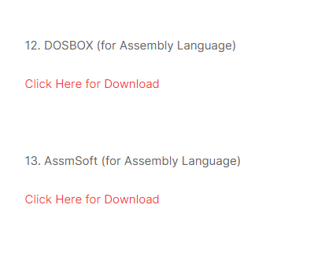
Installation of Assembly language IDEs.

Slide 14
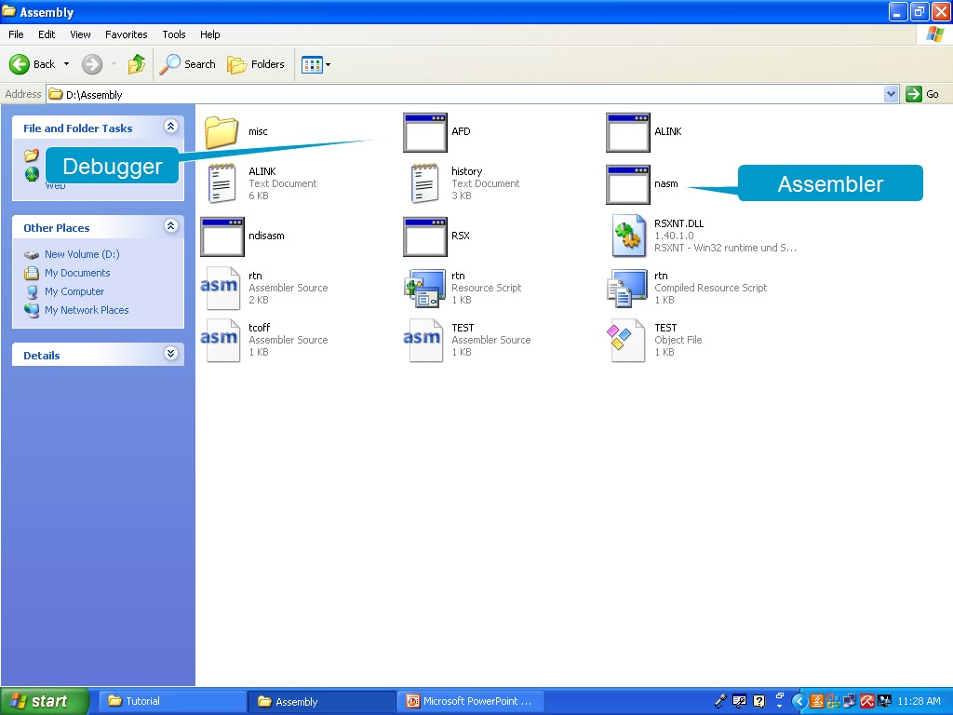
Installation of Assembly language IDEs.

Slide 15
Commands
Open Assmsoft folder and create a text file, and write the following code in it and save it as firstProgram.asm.
Code:
[org 0x100] ;start
mov ax, 6
mov bx, 1
add ax,bx
mov bx,4
mov ax, 0x4c00 ; terminate
int 0x21

Slide 16
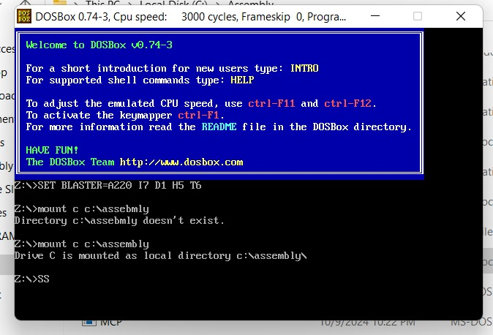
Commands
Open Assmsoft folder and create a text file, and write the following code in it and save it as firstProgram.asm.
Code:
[org 0x100] ;start
mov ax, 6
mov bx, 1
add ax,bx
mov bx,4
mov ax, 0x4c00 ; terminate
int 0x21

Slide 17
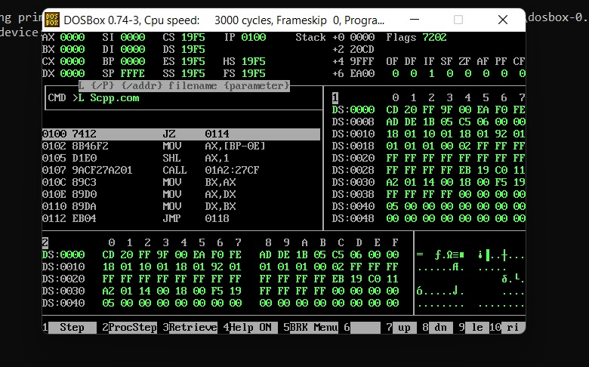
Commands
Open Assmsoft folder and create a text file, and write the following code in it and save it as firstProgram.asm.
Code:
[org 0x100] ;start
mov ax, 6
mov bx, 1
add ax,bx
mov bx,4
mov ax, 0x4c00 ; terminate
int 0x21

Slide 18
Execute your first program
Open DosBox
Mount your Drive from by Default to desired directory.
Mount c c:\assembly
C:
Now convert your assembly code into machine language
nasm firstProgram.asm –o machineProgram.com
Now run your program
machineProgram.com
Now lets see how code is working
afd machineProgram.com

Slide 19
Thank you

